Slide 1



Draft Guidelines for Environmental Assessment in a Transboundary Context
Meeting of PAP/RAC Focal Points,
Split, Croatia, 8-9 May 2019
Marina Marković, Consultant, PAP/RAC

Slide 2
Context, the need for and purpose of the Guidelines
EAs widely used across the Mediterranean, various regulatory frameworks apply:
BC/ ICZM Protocol
UNECE agreements: Espoo Convention and Kiev Protocol
EU Directives
Article 4 of the Convention (paragraphs 3(c) and 3(d))
… the Contracting Parties shall:
(c) undertake environmental impact assessment…
d) promote cooperation between and among States… on the basis of notification, exchange of information and consultation
2
Slide numbers to be added
as shown alongside

Slide 3
Context, the need for and purpose of the Guidelines
Articles 19 and 29 of the ICZM Protocol
Parties to carry out EIA and SEA, and to cooperate in the assessments when significant adverse effects on the CZs of other Parties are likely, through notification, exchange of information and consultation.
Purpose of the Guidelines
Provide the BC CPs with an operational tool to carry out transboundary EAs procedures
Create a common reference framework through identification and promotion of a set of standards and good practice recommendations (notification, exchange of info, consultations)
Recommend courses of action to strengthen TB procedures
3
Slide numbers to be added
as shown alongside

Slide 4
How was the Guidelines prepared
“Mandate” for preparation: Article 29 of the ICZM Protocol and UN Environment/ MAP PoW 2018-2019
Steps undertaken:
Review of the BC/ ICZM Protocol requirements; review of available information on the implementation
Review of other applicable frameworks (UNECE, EU)
Identification of standards/ good practices (implementation of UNECE and EU instruments)
Guidelines for the BC area (minimum requirements and good practices)
Good practice cases (FPs welcome to provide other examples)
Suggestions for the way forward
4

Slide 5
Current state of play in the Mediterranean
Practically all the BC CPs apply EIA procedures: EIA legislation in place in at least 20 CPs, 12 CPs reported on mechanisms for notification, exchange of information and consultations
EIA legislation in countries outside the EU/ UNECE areas in principle without provisions on TB procedures
SEAs predominantly used in the EU members and candidates; examples of good practice TB SEAs found in the Mediterranean but further efforts needed
A number of countries not Parties to either the ICZM Protocol or UNECE instruments (capacity building important)
Relevance of other policy frameworks: UNECE agreements may become open for other countries; the EU accession and neighborhood policies
5

Slide 6
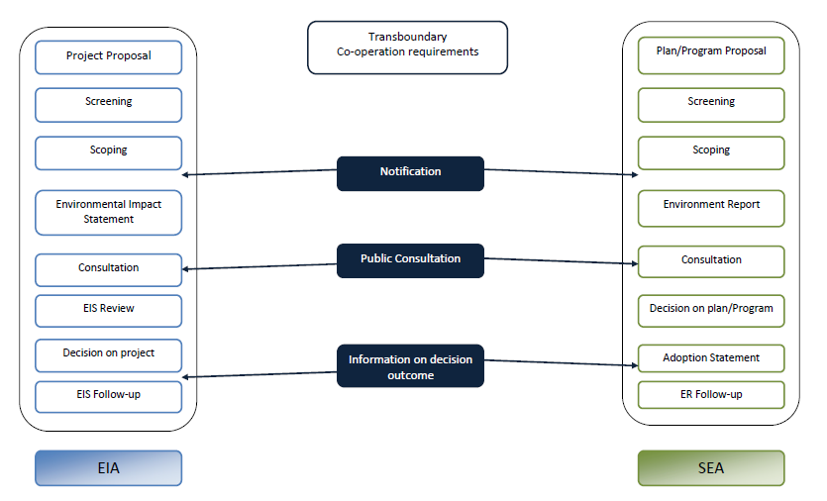

Slide 7
Notification procedures: basic requirements
The country of origin to notify the affected country as early as possible (but no later than its own public)
Notification is necessary unless significant TB impacts can be ruled out with certainty
Potentially affected countries have the right to request notification
Notification should (as a minimum) contain: information on the proposed activity, plan or programme (including on possible TB impacts; information on the nature of the decision; period within which the notified country should reply
Notifications to be sent to responsible (competent) EIA/ SEA authorities
Notification should be translated
7

Slide 8
Exchange of information: basic requirements
Exchange of information is a crucial part of TB procedures – from notification to decision-making
‘Reasonably obtainable information’ may be requested from the affected country already at notification stage
After completion of the assessment, the country of origin shares the assessment documentation with the affected country
The assessment documentation is shared through the competent authority; the key information should be translated and timeframes for reaction proposed
The final decision is provided to the affected country, with supporting information (including on how the comments were addressed)
8

Slide 9
Consultations: basic requirements
Consultations in TB procedures refer to cooperation and exchange of opinions between concerned countries, public participation and provision of comments
Concerned countries to ensure effective participation of the relevant authorities and the public (dissemination of information, timeframes, appropriate means of PP)
Opportunities to be ensured for the public of the country of origin and of the affected country to comment/ object; focus on the areas likely to be affected
Effectiveness of public hearings should be ensured
Outcomes of consultations should be properly noted and taken into account in decision-making
9

Slide 10
Needs and ways to strengthen TB EIA and SEA procedures in the BC area
Amend/ strengthen legislation (develop legal frameworks in the CPs that do not have provisions on TB EIA and SEA)
Promote ratification of the ICZM Protocol
Strengthen capacities for TB EAs (harmonised procedures and assessment methods, criteria on significance of TB impacts, joint monitoring programmes)
Encourage use of existing/ emerging guidelines (at the BC and EU levels) to better address specificities of marine environment
Promote Mediterranean good practices, facilitate exchanges
Promote UNECE agreements, tap UNECE capacity building opportunities
10

Slide 11
Needs and ways to strengthen TB EIA and SEA procedures in the BC area
Further considerations (UN Environment MAP and the CPs) on the assessment procedures for impacts on ABNJs
Promote the use of bilateral/ multilateral agreements to enhance effectiveness of TB EAs
Strengthen the Compliance Committee’s functions to ensure the Convention/ Protocol provisions on TB EAs are implemented
Conduct periodic assessments on the implementation of the Convention/ Protocol provisions on TB EAs
11

Slide 12


Thank you
Marina Marković, Consultant
Donja Gorica bb, 81000 Podgorica
Montenegro
marina.markovic@t-com.me
+382 67 22 00 33
www.paprac.org

